Slide 1
Enigma Machine
19BCE259 | 19BCE270| 19BCE273

Slide 2
Introduction & History
Enigma machine - A cipher device used in military communication
Used by Nazi in world war II
Uses rotor mechanism that scrambles 26 alphabets
158,962,555,217,826,360,000 patterns of combination
Used different pattern for each day
Alan Turing decoded it - bombe machine

Slide 3
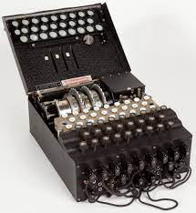

Slide 4
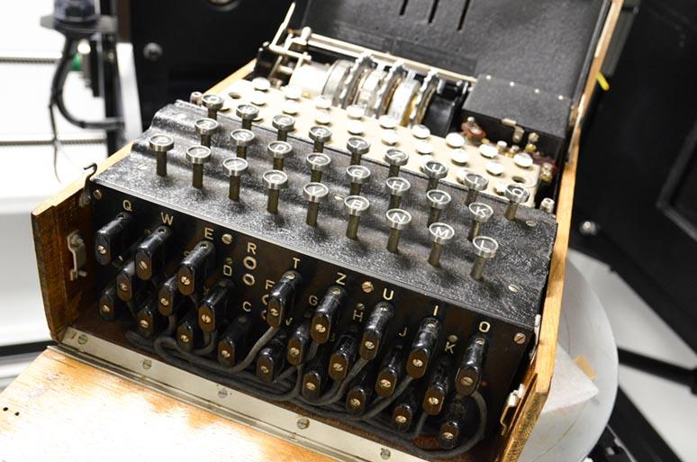
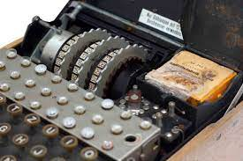

Slide 5
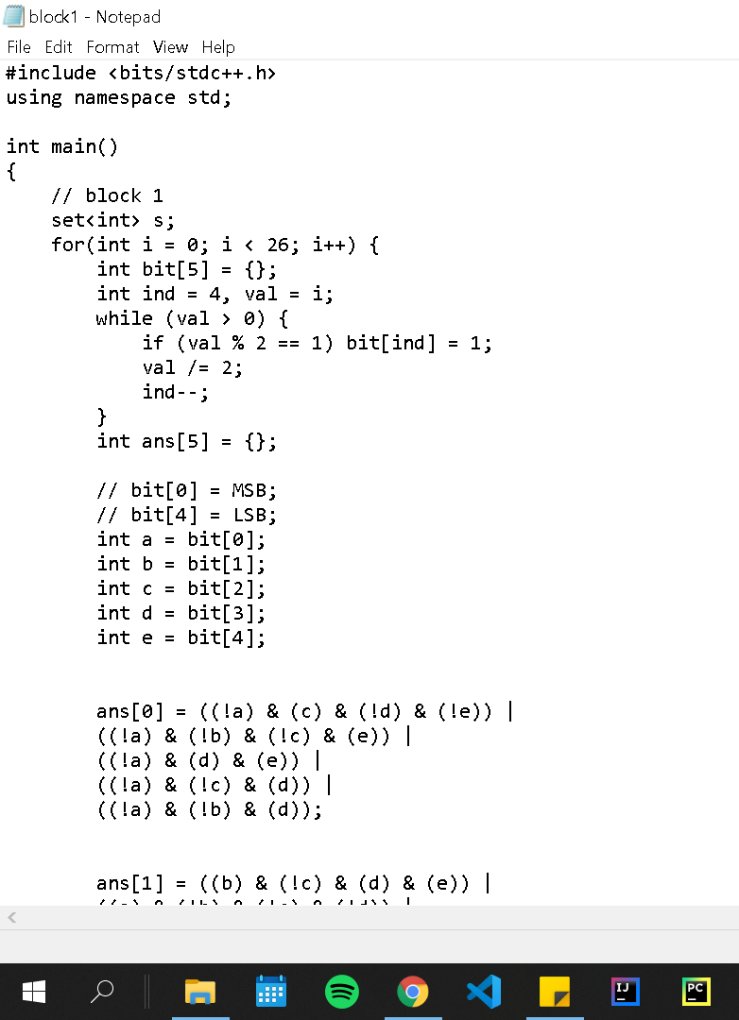
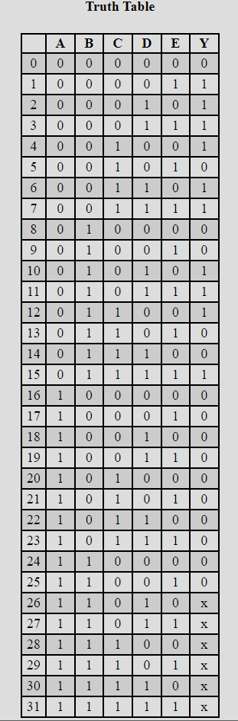
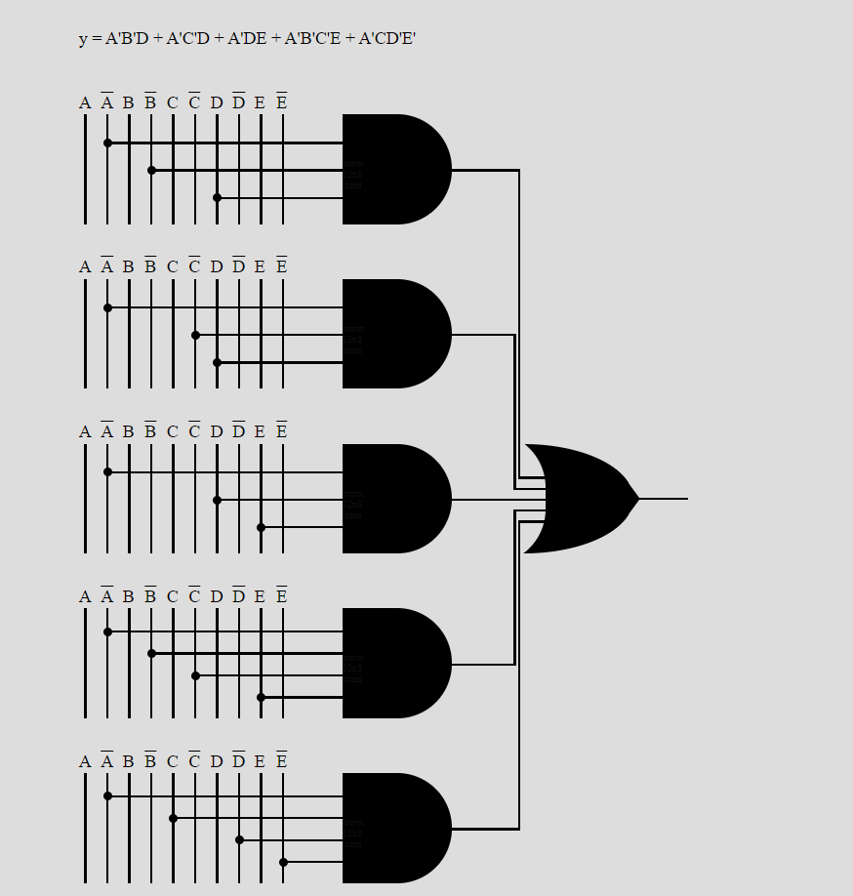

Slide 6
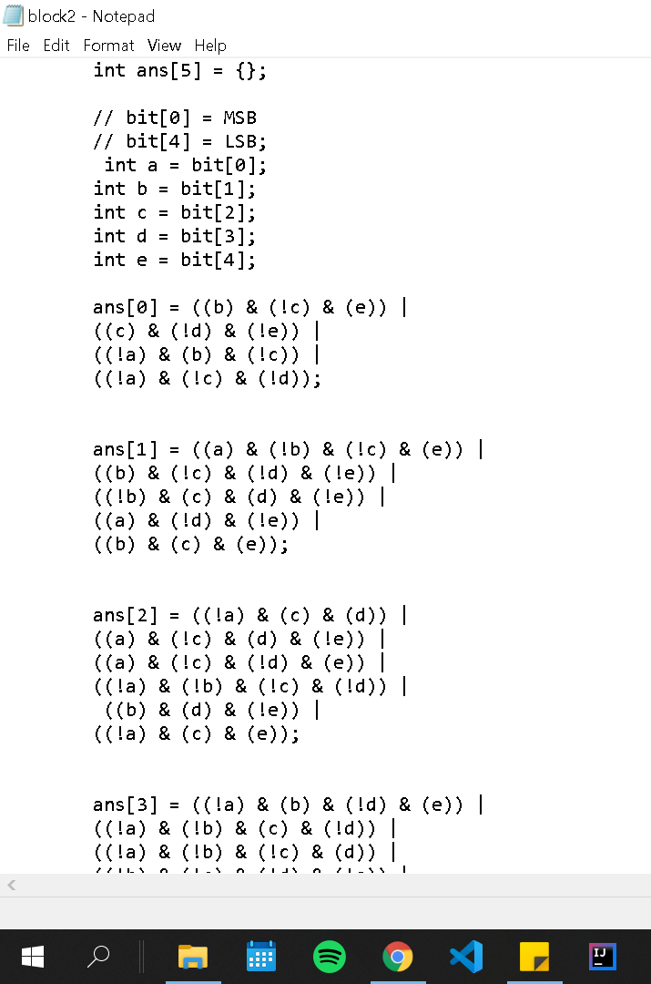
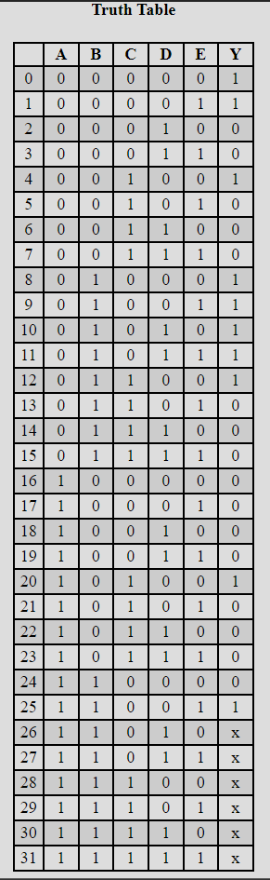
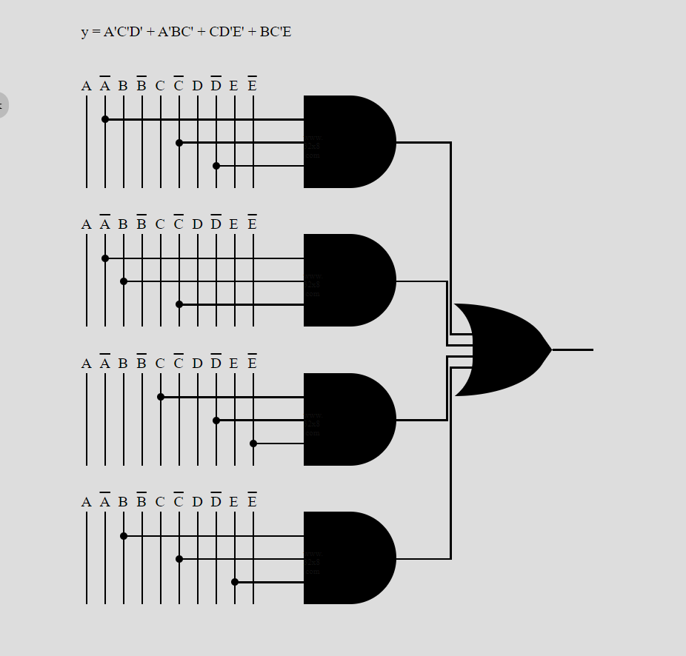

Slide 7
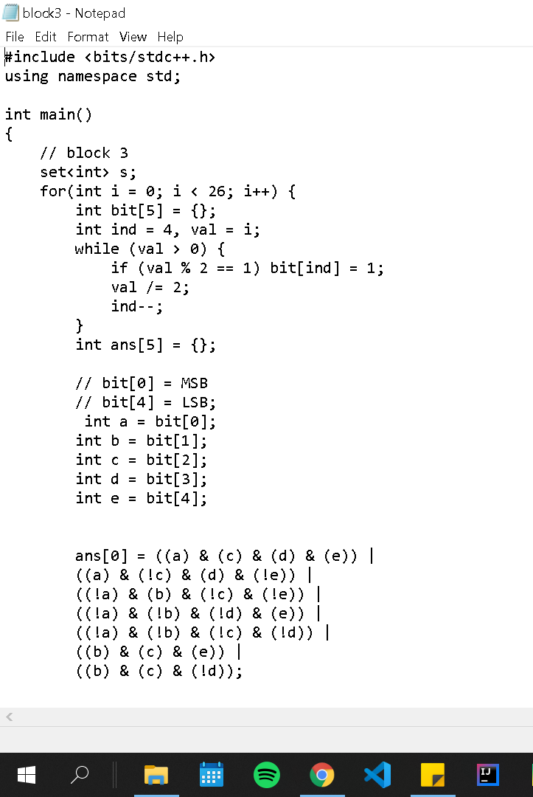
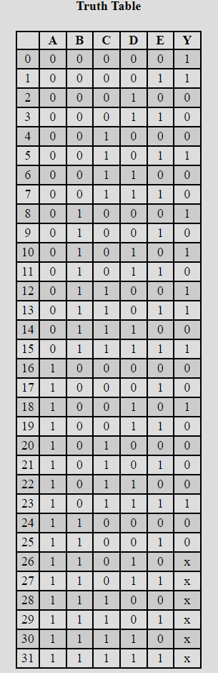
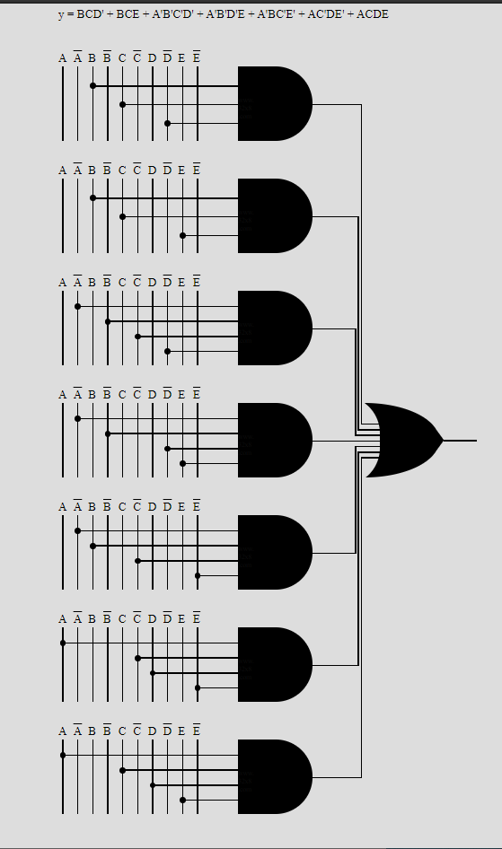

Slide 8
